Slide 1



GRADLE
DevOps IA-1
Kshitij Pandey
16010122129, C1
Faculty: Prof. Swapnil Pawar

Slide 2
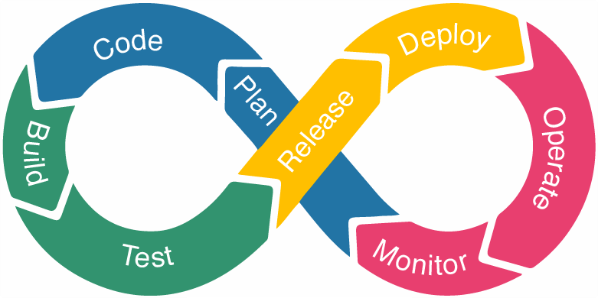
DevOps Phases
GRADLE

Slide 3
Introduction
Gradle is an open-source build automation tool.
It works with Java, Android, Kotlin, and more.
It handles dependency management and incremental builds.
It easily integrates with Jenkins, Docker, and Kubernetes.
Build file name is build.gradle

Slide 4
Workflow
In this presentation, we'll use Gradle in a Spring Boot project within IntelliJ IDEA.
We'll build and run the code using Gradle commands.
A simple REST API will be created to test the build and run success.
This demonstrates the practical use of Gradle for project automation and management.

Slide 5


Slide 6
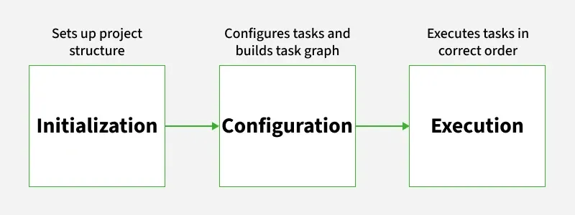
Gradle build lifecycle

Slide 7
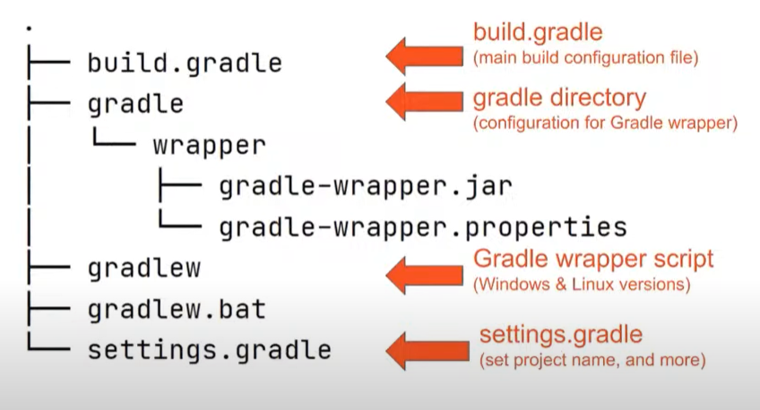
Gradle Project Structure

Slide 8
THANK YOU

